Slide 1
Language Fundamentals
Smita B Kumar

Slide 2

Language Fundamentals (8 Hrs.) Introduction to Java Platforms Variables, Methods and Data Types Operators, Control Structures Arrays, Arguments Access Specifiers Command line Classes and Objects Scanner Class Packages

Slide 3
Introduction Java Platforms
Developed by : James Gosling
Released and Controlled by Sun Microsystems, USA
Some important features :
Simplicity
Syntax borrowed from C++, eliminating the complex pointer concept.
Object Oriented Programming
Supports all features of OOP’s.
Secure
Type-checked language.
Platform independence.
Write Once, Compile Once, Run Anywhere feature.

Slide 4
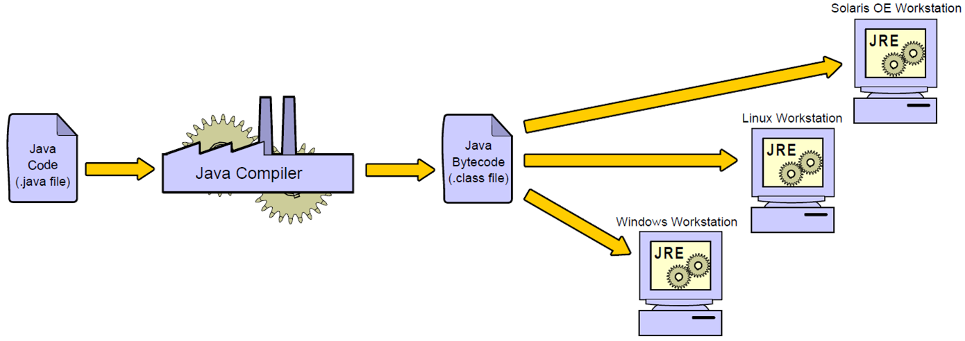
Java Programs Are Platform-Independent
Notes:
Platform-Independent Programs
Java technology applications are written in the Java programming language and compiled to Java bytecode. Bytecode is executed on the Java platform. The software that provides you with a runnable Java platform is called a Java Runtime Environment (JRE). A compiler, included in the Java SE Development Kit (JDK), is used to convert Java source code to Java bytecode.

Slide 5






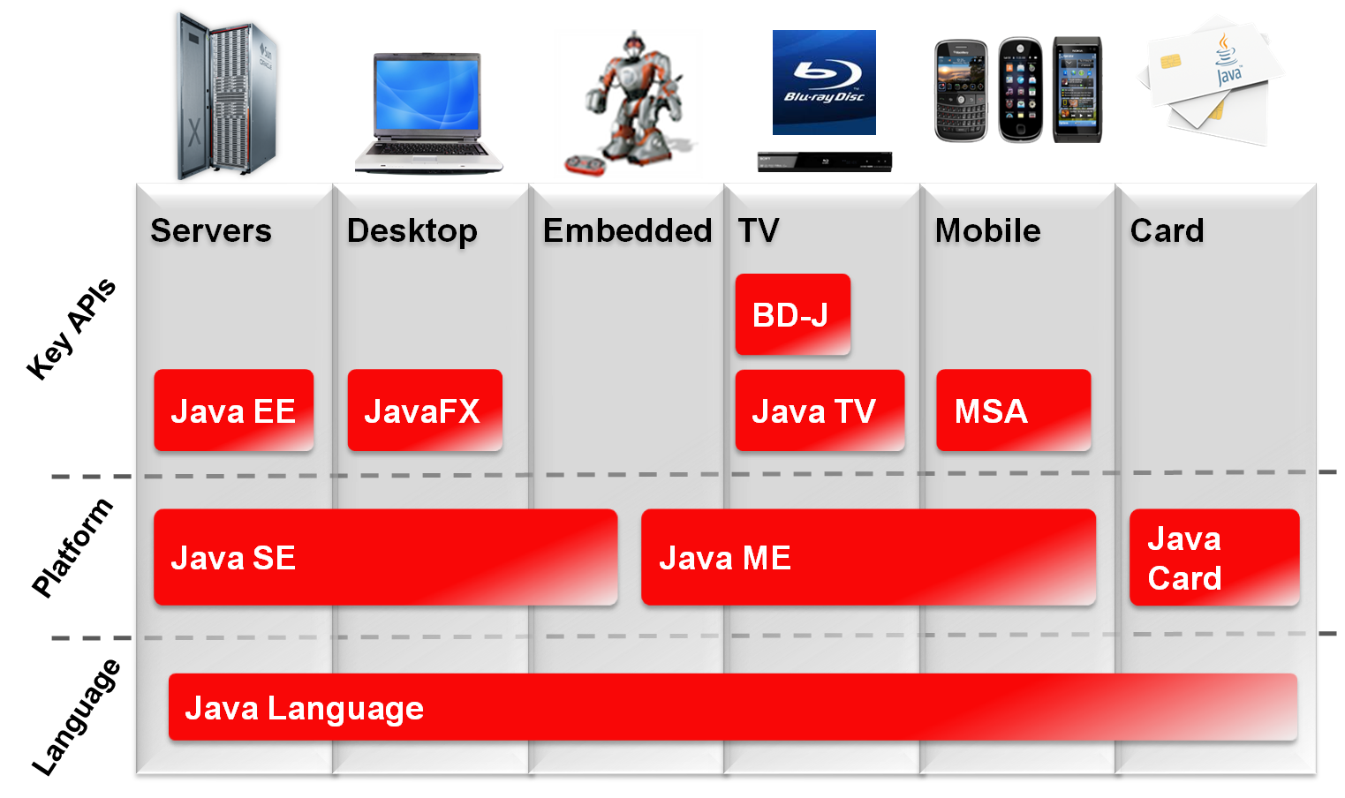
Java Technology Product Groups
Notes:
Identifying Java Technology Groups
Oracle provides a complete line of Java technology products ranging from kits that create Java technology programs to emulation (testing) environments for consumer devices, such as cellular phones. As indicated in the graphic, all Java technology products share the foundation of the Java language. Java technologies, such as the Java Virtual Machine, are included (in different forms) in three different groups of products, each designed to fulfill the needs of a particular target market. The figure illustrates the three Java technology product groups and their target device types. Among other Java technologies, each edition includes a Software Development kit (SDK) that allows programmers to create, compile, and execute Java technology programs on a particular platform:
Java Platform, Standard Edition (Java SE): Develops applets and applications that run within Web browsers and on desktop computers, respectively. For example, you can use the Java SE Software Development Kit (SDK) to create a word processing program for a personal computer. You can also use the Java SE to create an application that runs in a browser.
Note: Applets and applications differ in several ways. Primarily, applets are launched inside a web browser, whereas applications are launched within an operating system.

Slide 6
Java SE Platform Versions
Version Name | Code Name | Release Date
JDK 1.0 | Oak | January 1996
JDK 1.1 | (none) | February 1997
J2SE 1.2 | Playground | December 1998
J2SE 1.3 | Kestrel | May 2000
J2SE 1.4 | Merlin | February 2002
J2SE 5.0 | Tiger | September 2004
Java SE 6 | Mustang | December 2006
Java SE 7 | Dolphin | July 2011
Java SE 8 |  | March 2014
Java SE 9 |  | September, 21st 2017
Java SE 10 |  | March, 20th 2018
Java SE 11 |  | 2018(Future release)
Notes:
How to Detect Your Version
If Java SE is installed on your system, you can detect the version number by running java ‑version. Note that the java command is included with the Java Runtime Environment (JRE). As a developer, you also need a Java compiler, typically javac. The javac command is included in the Java SE Development Kit (JDK). Your operation system’s PATH may need to be updated to include the location of javac.

Slide 7
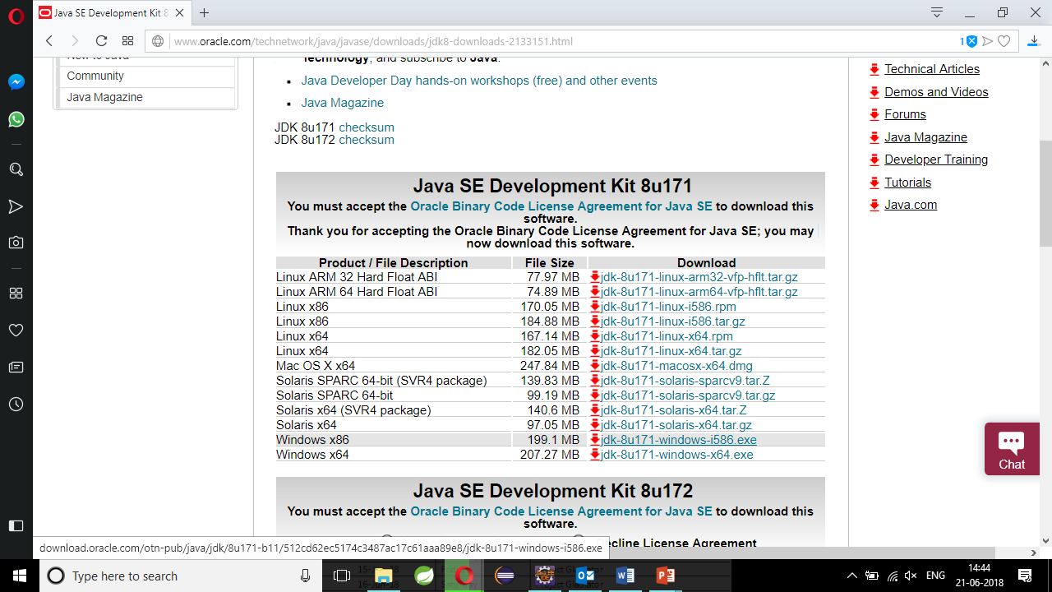
Downloading and Installing the JDK
Notes:
1. Go to http://www.oracle.com/technetwork/java/javase/downloads/index.html.
2. Choose the Java Platform, Standard Edition (Java SE) link.
3. Download the version that is appropriate for your operation system.
4. Follow the installation instructions.
5. Set your PATH.

Slide 8

Java in Server Environments
Java is common in enterprise environments:
Oracle Fusion Middleware
Java application servers
GlassFish
WebLogic
Wildfly
Database servers
MySQL
Oracle Database
Notes:
Enterprise Environments
In this course, you develop Java SE applications. There are standard patterns you need to follow when implementing Java SE applications, such as always creating a main method that may be different when implementing enterprise applications. Java SE is only the starting point in your path to becoming a Java developer. Depending on the needs of your organization, you may be required to develop applications that run inside Java EE application servers or other types of Java middleware.
Often, you will also need to manipulate information stored inside relational databases such as MySQL or Oracle Database. This course introduces you to the fundamentals of database programming.

Slide 9













The Java Community
Mobile & Embedded
Notes:
What Is the Java Community?
At a very high level, Java Community is the term used to refer to the many individuals and organizations that develop, innovate, and use Java technology. This community includes developers as individuals, organizations, businesses, and open-source projects.
It is very common for you to download and use Java libraries from non-Oracle sources within the Java community. For instance, in this course, you use an Apache-developed JDBC library to access a relational database.
Apache Software Foundation

Slide 10

Java Language Review
Now we will take a review of fundamental Java and programming concepts. It is assumed that participants are familiar with the following concepts:
The basic structure of a Java class
Program block and comments
Variables
Basic if-else and switch branching constructs
Iteration with for and while loops

Slide 11
Class Structure
package <package_name>;
import <other_packages>;
public class ClassName {
<variables(also known as fields)>;
<constructor method(s)>;
<other methods>;
}
Notes:
A Java class is described in a text file with a .java extension. In the example shown, the Java keywords are highlighted in bold.
The package keyword defines where this class lives relative to other classes, and provides a level of access control. You use access modifiers (such as public and private) later in this lesson.
The import keyword defines other classes or groups of classes that you are using in your class. The import statement helps to narrow what the compiler needs to look for when resolving class names used in this class.
The class keyword precedes the name of this class. The name of the class and the file name must match when the class is declared public (which is a good practice). However, the keyword public in front of the class keyword is a modifier and is not required.
Variables, or the data associated with programs (such as integers, strings, arrays, and references to other objects), are called instance fields (often shortened to fields).
Constructors are functions called during the creation (instantiation) of an object (a representation in memory of a Java class.)
Methods are the functions that can be performed on an object. They are also referred to as instance methods.

Slide 12
A Simple Class
A simple Java class with a main method:
public class Simple {
public static void main(String args[]){
}
}
Notes:
To run a Java program, you must define a main method as shown in the slide. The main method is automatically called when the class is called from the command line. Command-line arguments are passed to the program through the args[] array.
Note: A method that is modified with the keyword static is invoked without a reference to a particular object. The class name is used instead. These methods are referred to as class methods. The main method is a special method that is invoked when this class is run using the Java runtime.

Slide 13
Code Blocks
Every class declaration is enclosed in a code block.
Method declarations are enclosed in code blocks.
Java fields and methods have block (or class) scope.
Code blocks are defined in braces:
{ }
Example:
public class SayHello {
public static void main(String[] args) {
System.out.println("Hello world");
}
}
Notes:
Java fields (variables) and methods have a class scope defined by the opening left curly brace and ending at the closing right curly brace.
Class scope allows any method in the class to call or invoke any other method in the class. Class scope also allows any method to access any field in the class.
Code blocks are always defined using braces {}. A block is executed by executing each of the statements defined within the block in order from first to last (left to right).
The Java compiler ignores white space that precedes or follows the elements that make up a line of code. Line indentation is not required but makes code much more readable. In this course, the line indentation is four spaces, which is the default line indentation used by the NetBeans IDE.

Slide 14
How to Compile and Run
Java class files must be compiled before running them. To compile a Java source file, use the Java compiler (javac).
javac –cp <path to other classes> -d <complier output path> <path to source>.java
You can use the CLASSPATH environment variable to the directory above the location of the package hierarchy.
After compiling the source .java file, a .class file is generated.
To run the Java application, run it using the Java interpreter (java):
java –cp <path to other classes> <package name>.<classname>
Notes:
CLASSPATH
The default value of the classpath is the current working directory (.), however, specifying the CLASSPATH variable or the –cp command line switch overrides this value.
The CLASSPATH variable is used by both the Java compiler and the Java interpreter (runtime).
The classpath can include:
A list of directory names (separated by semicolons in Windows and colons in UNIX)
The classes are in a package tree relative to any of the directories on the list.
A .zip or .jar file name that is fully qualified with its path name
The classes in these files must be zipped with the path names that are derived from the directories formed by their package names.
Note: The directory containing the root name of the package tree must be added to the classpath. Consider putting classpath information in the command window or even in the Java command, rather than hard-coding it in the environment.

Slide 15
Compiling and Running: Example
Assume that the class shown in the notes is in the directory D:\test\com\example:
javac –d D:\test D:\test\com\example\HelloWorld.java
To run the application, you use the interpreter and the fully qualified class name:
java –cp D:\test com.example.HelloWorld
Hello World!
java –cp D:\test com.example.HelloWorld Tom
Hello Tom!
The advantage of an IDE like NetBeans is that management of the class path, compilation, and running the Java application are handled through the tool.
Notes:
Example
Consider the following simple class in a file named HelloWorld.java in the D:\test\com\example directory:
package com.example;
public class HelloWorld {
public static void main (String [] args) {
if (args.length < 1) {
System.out.println("Hello World!");
} else {
System.out.println("Hello " + args[0] + "!");
}
}
}

Slide 16
Java Class Loader
During execution of a Java program, the Java Virtual Machine loads the compiled Java class files using a Java class of its own called the “class loader” (java.lang.ClassLoader).
The class loader is called when a class member is used for the first time:
public class Test {
public void someOperation() {
Employee e = new Employee();
//...
}
}
Test.class.getClassLoader().loadClass("Employee");
The class loader is called to "load" this class into memory.
Notes:
Typically, the use of the class loader is completely invisible to you. You can see the results of the class loader by using the -verbose flag when you run your application. For example:
java –verbose –classpath D:\test com.example.HelloWorld
[Loaded java.lang.Object from shared objects file]
[Loaded java.io.Serializable from shared objects file]
[Loaded java.lang.Comparable from shared objects file]
[Loaded java.lang.CharSequence from shared objects file]
[Loaded java.lang.String from shared objects file]
[Loaded java.lang.reflect.GenericDeclaration from shared objects file]
[Loaded java.lang.reflect.Type from shared objects file]
[Loaded java.lang.reflect.AnnotatedElement from shared objects file]
[Loaded java.lang.Class from shared objects file]
[Loaded java.lang.Cloneable from shared objects file]
[Loaded java.lang.ClassLoader from shared objects file]
... and many more

Slide 17
Primitive Data Types
Append uppercase or lowercase "L" or "F" to the number to specify a long or a float number.
Integer | Floating Point | Character | True False
byte short int long | float double | char | boolean
1, 2, 3, 42 07 0xff | 3.0F .3337F 4.022E23 | 'a' '\u0061' '\n' | true false
0 | 0.0 | '\u0000' | false
Notes:
Integer
Java provides four different integer types to accommodate different size numbers. All the numeric types are signed, which means that they can hold positive or negative numbers.
The integer types have the following ranges:
byte range is –128 to +127. Number of bits = 8.
short range is –32,768 to +32,767. Number of bits = 16.
int range is –2,147,483,648 to +2,147,483,647. The most common integer type is int. Number of bits = 32.
long range is –9,223,372,036,854,775,808 to +9,223,372,036,854,775,807. Number of bits = 64.
Floating Point
The floating-point types hold numbers with a fractional part and conform to the IEEE 754 standard. There are two types of floating points: float and double.
double is so called because it provides double the precision of float. A float uses 32 bits to store data, whereas a double uses 64 bits.

Slide 18
Java SE 7 Numeric Literals
In Java SE 7 (and later versions), any number of underscore characters (_) can appear between digits in a numeric field. This can improve the readability of your code.
long creditCardNumber = 1234_5678_9012_3456L;
long socialSecurityNumber = 999_99_9999L;
long hexBytes = 0xFF_EC_DE_5E;
long hexWords = 0xCAFE_BABE;
long maxLong = 0x7fff_ffff_ffff_ffffL;
byte nybbles = 0b0010_0101;
long bytes = 0b11010010_01101001_10010100_10010010;
Notes:
Rules for Literals
You can place underscores only between digits; you cannot place underscores in the following places:
At the beginning or end of a number
Adjacent to a decimal point in a floating point literal
Prior to an F or L suffix
In positions where a string of digits is expected
Note: The Java language is case-sensitive. In Java, the variable creditCardNumber is different from CREDITCARDNUMBER. Convention indicates that Java variables and method names use “lower camel case”―lowercase for the first letter of the first element of a variable name and uppercase for the first letter of subsequent elements.

Slide 19
Java SE 7 Binary Literals
In Java SE 7 (and later versions), binary literals can also be expressed using the binary system by adding the prefixes 0b or 0B to the number:
// An 8-bit 'byte' value:
byte aByte = 0b0010_0001;
// A 16-bit 'short' value:
short aShort = (short)0b1010_0001_0100_0101;
// Some 32-bit 'int' values:
int anInt1 = 0b1010_0001_0100_0101_1010_0001_0100_0101;
int anInt2 = 0b101;
int anInt3 = 0B101; // The B can be upper or lower case.
Notes:
Binary literals are Java int values. A cast is required when the integer value of the literal exceeds the greatest non-negative value that the type can hold. For example:
byte aByte = 0b0111_1111; // aByte is 127
byte aByte = 0b1000_0000; // compiler error – a cast is required
// (value is -128)

Slide 20
Strings
public class Strings {
public static void main(String args[]){
char letter = 'a';
String string1 = "Hello";
String string2 = "World";
String string3 = "";
String dontDoThis = new String ("Bad Practice");
string3 = string1 + string2; // Concatenate strings
System.out.println("Output: " + string3 + " " + letter);
}
}
String literals are also String objects.
Notes:
The code in the slide demonstrates how text characters are represented in Java. Single characters can be represented with the char type. However, Java also includes a String type for representing multiple characters. Strings can be defined as shown in the slide and combined using the "+" sign as a concatenation operator.
The output from the code in the slide is:
Output: HelloWorld a
Caution: Strings should always be initialized using the assignment operator "=" and text in quotation marks, as shown in the examples. The use of new to initialize a String is strongly discouraged. The reason is that "Bad Practice" in line 10 is a String literal of type String, Using the new keyword simply creates another instance functionally identical to the literal. If this statement appeared inside of a loop that was frequently invoked, there could be a lot of needless String instances created.

Slide 21
String Operations
public class StringOperations {
public static void main(String arg[]){
String string2 = "World";
String string3 = "";
string3 = "Hello".concat(string2);
System.out.println("string3: " + string3);
// Get length
System.out.println("Length: " + string1.length());
// Get SubString
System.out.println("Sub: " + string3.substring(0, 5));
// Uppercase
System.out.println("Upper: " + string3.toUpperCase());
}
}
String literals are automatically created as String objects if necessary.
Notes:
This slide demonstrates some common string methods, including:
concat()
length()
substring()
toUpperCase()
To see what other methods can be used on a String, see the API documentation.
The output from the program is:
string3: HelloWorld
Length: 5
Sub: Hello
Upper: HELLOWORLD
Note: String is a class, not a primitive type. Instances of the class String represent sequences of Unicode characters. String literals are stored as String objects and "interned", meaning that for strings with matching characters, they all point to the same String object.

Slide 22
Operators
Simple assignment operator
= Simple assignment operator
Arithmetic operators
+ Additive operator (also used for String concatenation)
– Subtraction operator
* Multiplication operator
/ Division operator
% Remainder operator
Unary operators
+ Unary plus operator; indicates positive
– Unary minus operator; negates an expression
++ Increment operator; increments a value by 1
-- Decrement operator; decrements a value by 1
! Logical complement operator; inverts the value of a boolean
Notes:
Because numbers have been introduced, the slide shows a list of common operators. Most are common to any programming language, and a description of each is provided in the slide.
The binary and bitwise operators have been omitted for brevity. For details about those operators, refer to the Java Tutorial:
http://download.oracle.com/javase/tutorial/java/nutsandbolts/operators.html
Note: Operators have definitive precedence. For the complete list, see the Java Tutorial link mentioned above. Precedence can be overridden using parentheses.

Slide 23
if else
public class IfElse {
public static void main(String args[]){
long a = 1;
long b = 2;
if (a == b){
System.out.println("True");
} else {
System.out.println("False");
}
}
}
Notes:
The example in the slide demonstrates the syntax for an if-else statement in Java.
The output from the code in the slide is as follows:
False

Slide 24
Logical Operators
Equality and relational operators
== Equal to
!= Not equal to
> Greater than
>= Greater than or equal to
< Less than
<= Less than or equal to
Conditional operators
&& Conditional-AND
|| Conditional-OR
?: Ternary (shorthand for if-then-else statement)
Type comparison operator
instanceof Compares an object to a specified type
Notes:
The slide shows a summary of the logic and conditional operators in Java.

Slide 25
Arrays and for-each Loop
public class ArrayOperations {
public static void main(String args[]){
String[] names = new String[3];
names[0] = "Blue Shirt";
names[1] = "Red Shirt";
names[2] = "Black Shirt";
int[] numbers = {100, 200, 300};
for (String name:names){
System.out.println("Name: " + name);
}
for (int number:numbers){
System.out.println("Number: " + number);
}
}
}
Arrays are objects. Array objects have a final field length.
Notes:
This class demonstrates how to define arrays in Java. The first example creates a String array and initializes each element separately. The second int array is defined in a single statement.
Each array is iterated through using the Java for-each construct. The loop defines an element which will represent each element of the array and the array to loop through. The output of the class is shown here:
Name: Blue Shirt
Name: Red Shirt
Name: Black Shirt
Number: 100
Number: 200
Number: 300
Note: Arrays are also objects by default. All arrays support the methods of the class Object. You can always obtain the size of an array using its length field.

Slide 26
for Loop
public class ForLoop {
public static void main(String args[]){
for (int i = 0; i < 9; i++ ){
System.out.println("i: " + i);
}
}
}
Notes:
The classic for loop is shown in the slide. A counter is initialized and incremented for each step of the loop. When the condition statement evaluates to false (when i is no longer less than 9), the loop exits. Here is the sample output for this program.
i: 0
i: 1
i: 2
i: 3
i: 4
i: 5
i: 6
i: 7
i: 8

Slide 27
while Loop
public class WhileLoop {
public static void main(String args[]){
int i = 0;
int[] numbers = {100, 200, 300};
while (i < numbers.length ){
System.out.println("Number: " + numbers[i]);
i++;
}
}
}
Notes:
The while loop performs a test and continues if the expression evaluates to true. The while loop, shown here, iterates through an array using a counter. Here is the output from the code in the slide:
Number: 100
Number: 200
Number: 300
Note: There is also a do-while loop, where the test after the expression has run at least once:
class DoWhileDemo {
public static void main(String[] args){
int count = 1;
do {
System.out.println("Count is: " + count);
count++;
} while (count <= 11);
}
}

Slide 28
String switch Statement
public class SwitchStringStatement {
public static void main(String args[]){
String color = "Blue";
String shirt = " Shirt";
switch (color){
case "Blue":
shirt = "Blue" + shirt;
break;
case "Red":
shirt = "Red" + shirt;
break;
default:
shirt = "White" + shirt;
}
System.out.println("Shirt type: " + shirt);
}
}
Notes:
This example shows a switch statement in Java using a String. Prior to version 7 of Java, only enums and byte, short, char, and int primitive data types could be used in a switch statement. You will see enums in the lesson titled “Advanced Class Design.”

Slide 29
Java Naming Conventions
Class names are nouns in upper camel case.
public class CreditCard {
public final int VISA = 5001;
public String accountName;
public String cardNumber;
public Date expDate;
public double getCharges(){
// ...
}
public void disputeCharge(String chargeId, float amount){
// ...
}
}
Constants should be declared in all uppercase. letters
Variable names are short but meaningful in lower camel case.
Methods should be verbs, in lower camel case.
Notes:
Class names should be nouns in mixed case, with the first letter uppercase and the first letter of each internal word capitalized. This is approach is termed "upper camel case."
Methods should be verbs in mixed case, with the first letter lowercase and the first letter of each internal word capitalized. This is termed "lower camel case."
Variable names should be short but meaningful. The choice of a variable name should be mnemonic: designed to indicate to the casual observer the intent of its use.
One-character variable names should be avoided except as temporary "throwaway" variables.
Constants should be declared using all uppercase letters. Note: The keyword final is used to declare a variable whose value may only be assigned once. Once a final variable has been assigned, it always contains the same value. You will learn more about the keyword final in the lesson "Advanced Class Design."
For the complete Code Conventions for the Java Programming Language document, go to http://www.oracle.com/technetwork/java/codeconv-138413.html.

Slide 30
A Simple Java Class: Employee
A Java class is often used to represent a concept.
package com.example.domain;
public class Employee {
public int empId;
public String name;
public String ssn;
public double salary;
public Employee () {
}
public int getEmpId () {
return empId;
}
}
class declaration
fields
a constructor
a method
Notes:
A Java class is often used to store or represent data for the construct that the class represents. For example, you could create a model (a programmatic representation) of an Employee. An Employee object defined using this model will contain values for empId, name, Social Security Number (ssn), and salary.
The constructor in this class creates an instance of an object called Employee.
A constructor is unique in Java. A constructor is used to create an instance of a class. Unlike methods, constructors do not declare a return type, and are declared with the same name as their class. Constructors can take arguments and you can declare more than one constructor, as you will see in the lesson titled “Java Class Design.”

Slide 31
Methods
When a class has data fields, a common practice is to provide methods for storing data (setter methods) and retrieving data (getter methods) from the fields.
package com.example.domain;
public class Employee {
public int empId;
// other fields...
public void setEmpId(int empId) {
this.empId = empId;
}
public int getEmpId() {
return empId;
}
// getter/setter methods for other fields...
}
Often a pair of methods to set and get the current field value.
Notes:
Adding Instance Methods to the Employee Class
A common practice is to create a set of methods that manipulate field data: methods that set the value of each field, and methods that get the value of each field. These methods are called accessors (getters) and mutators (setters).
The convention is to use set and get plus the name of the field with the first letter of the field name capitalized (lower camel case). Most modern integrated development environments (IDEs) provide an easy way to automatically generate the accessor (getter) and mutator (setter) methods for you.
Notice that the set methods use the keyword this. The this keyword allows the compiler to distinguish between the field name of the class (this) and the parameter name being passed in as an argument. Without the keyword this, the net effect is you are assigning a value to itself. (In fact, NetBeans provides a warning: "Assignment to self.")
In this simple example, you could use the setName method to change the employee name and the setSalary method to change the employee salary.
Note: The methods declared on this slide are called instance methods. They are invoked using an instance of this class (described on the next slide.)

Slide 32
Creating an Instance of an Object
To construct or create an instance (object) of the Employee class, use the new keyword.
/* In some other class, or a main method */
Employee emp = new Employee();
emp.empId = 101; // legal if the field is public,
// but not good OO practice
emp.setEmpId(101); // use a method instead
emp.setName("John Smith");
emp.setSsn("011-22-3467");
emp.setSalary(120345.27);
In this fragment of Java code, you construct an instance of the Employee class and assign the reference to the new object to a variable called emp.
Then you assign values to the Employee object.
Invoking an instance method.
Notes:
Creating an instance of the Employee Class
In order to use the Employee class to hold the information of an employee, you need to allocate memory for the Employee object and call a constructor method in the class. An instance of an object is created when you use the new keyword with a constructor. All of the fields declared in the class are provided memory space and initialized to their default values. If the memory allocation and constructor are successful, a reference to the object is returned as a result. In the example in the slide, the reference is assigned to a variable called emp.
To store values (data) into the Employee object instance, you could just assign values to each field by accessing the fields directly. However, this is not a good practice and negates the principle of encapsulation. Instead, you should invoke instance methods and pass a value to the method to set the value of each data field. Later in this lesson you will look at restricting access to the fields to promote encapsulation.
Once all the data fields are set with values, you have an instance of an Employee with an empId with a value of 101, name with the string John Smith, Social Security number string (ssn) set to 011-22-3467, and salary with the value of 120,345.27.

Slide 33
Constructors
public class Employee {
public Employee() {
}
}
Employee emp = new Employee();
A constructor is used to create an instance of a class.
Constructors can take parameters.
A constructor that takes no arguments is called a no-arg constructor.
A simple no-argument (no-arg) constructor.
Notes:
A constructor is used to create an object. In the Java programming language, constructors are declared with the same name as their class used to create an instance of an object. Constructors are invoked using the new keyword.
Constructors are covered in more detail in the lesson titled “Encapsulation and Subclassing.”

Slide 34
Command-Line Arguments
Any Java technology application can use command‑line arguments.
These string arguments are placed on the command line to launch the Java interpreter after the class name:
java TestArgs arg1 arg2 "another arg"
Each command-line argument is placed in the args array that is passed to the static main method:
public static void main(String[] args)
Notes:
When a Java program is launched from a terminal window, you can provide the program with zero or more command-line arguments.
These command-line arguments enable the user to specify the configuration information for the application. These arguments are strings: either stand-alone tokens (such as arg1) or quoted strings (such as "another arg").

Slide 35
Command-Line Arguments
public class TestArgs {
public static void main(String[] args) {
for ( int i = 0; i < args.length; i++ ) {
System.out.println("args[" + i + "] is '" +
args[i] + "'");
}
}
}
Example execution:
java TestArgs "Ted Baxter" 45 100.25
args[0] is 'Ted Baxter'
args[1] is '45'
args[2] is '100.25'
Notes:
Command-line arguments are always passed to the main method as strings, regardless of their intended type. If an application requires command-line arguments other than type String (for example, numeric values), the application should convert the string arguments to their respective types using the wrapper classes, such as the Integer.parseInt method, which can be used to convert the string argument that represents the numeric integer to type int.

Slide 36
package Statement
The package keyword is used in Java to group classes together. A package is implemented as a folder and, like a folder, provides a namespace to a class.
namespace view
folder view
com.example.domain
+com
|_+example
|_+domain
|_+Employee.java
|_+Manager.java
Employee
Manager
Always declare a package!
Notes:
Packages
In Java, a package is a group of (class) types. There can be only one package declaration for a file.
Packages are more than just a convenience. Packages create a namespace, a logical collection of things, like a directory hierarchy.
It is a good practice to always use a package declaration. The package declaration is always at the top of the file.

Slide 37
import Statements
The import keyword is used to identify classes you want to reference in your class.
The import statement provides a convenient way to identify classes that you want to reference in your class.
import java.util.Date;
You can import a single class or an entire package:
import java.util.*;
You can include multiple import statements:
import java.util.Date;
import java.util.Calendar;
It is good practice to use the full package and class name rather than the wildcard * to avoid class name conflicts.
Notes:
Imports
You could refer to a class using its fully qualified namespace in your applications, as in the following example:
java.util.Date date = new java.util.Date();
But that would quickly lead to a lot of typing! Instead, Java provides the import statement to allow you to declare that you want to reference a class in another package.
Note: It is a good practice to use the specific, fully qualified package and class name to avoid confusion when there are two classes with the same name, as in the following example: java.sql.Date and java.util.Date. The first is a Date class used to store a Date type in a database, and java.util.Date is a general purpose Date class. As it turns out, java.sql.Date is a subclass of java.util.Date. This is covered in more detail later in the course.
Note: Modern IDEs, like NetBeans and Eclipse, automatically search for and add import statements for you. In NetBeans, for example, use the Ctrl + Shift + I key sequence to fix imports in your code.

Slide 38
More on import
Import statements follow the package declaration and precede the class declaration.
An import statement is not required.
By default, your class always imports java.lang.*
You do not need to import classes that are in the same package:
package com.example.domain;
import com.example.domain.Manager; // unused import
Notes:
Details about the java.lang package and its classes are covered later in the course.

Slide 39
Java Is Pass-By-Value
The Java language (unlike C++) uses pass-by-value for all assignment operations.
To visualize this with primitives, consider the following:
int x = 3;
int y = x;
The value of x is copied and passed to y:
If x is later modified (for example, x = 5;), the value of y remains unchanged.
3
3
x
y
copy the value of x
Notes:
The Java language uses pass-by-value for all assignment operations. This means that the argument on the right side of the equal sign is evaluated, and the value of the argument is assigned to the left side of the equal sign.
For Java primitives, this is straightforward. Java does not pass a reference to a primitive (such as an integer), but rather a copy of the value.

Slide 40
Pass-By-Value for Object References
Employee x = new Employee();
Employee y = x;
The reference is some address in memory.
After the assignment, the value of y is the same as the value of x: a reference to the same Employee object.
42
memory address = 42
x
Employee object
y = x;
42
y
Notes:
For Java objects, the value of an object reference is the memory pointer to the instance of the Employee object created.
When you assign the value of x to y, you are not creating a new Employee object, but rather a copy of the value of the reference.
Note: An object is a class instance or an array. The reference values (references) are pointers to these objects, and a special null reference, which refers to no object.

Slide 41
Objects Passed as Parameters
Whenever a new object is created, a new reference is created. Consider the following code fragments:
Employee x = new Employee();
foo(x);
public void foo(Employee e) {
e = new Employee();
e.setSalary (1_000_000.00); // What happens to x here?
}
The value of x is unchanged as a result of the method call foo:
42
Employee object
x
99
Employee object
e
Notes:
In the first line of code, a new object (Employee) is created and the reference to that object is assigned to the variable x.
In the second line of code, the value of that reference is passed to a method called foo.
When the foo method is called, (Employee e) holds a reference to the Employee object, x. In the next line, the value of e is now a new Employee object, by virtue of the call to the constructor.
The reference to the x object is replaced by a reference to a new object. The x object remains unchanged.
Note: The object e, created inside of the method foo, can no longer be referenced when the method finishes. As a result, it will be eligible for garbage collection at some future point.
If the code in the foo method was written differently, like this: public void foo(Employee e) {
e.setSalary(1_000_000.00): }
Then referenced object that the setSalary method is being called on is the object referenced by x, and after the foo method returns, the object x is modified..
Note: The memory locations 42 and 99 are simply for illustrative purposes!

Slide 42
Garbage Collection
When an object is instantiated using the new keyword, memory is allocated for the object. The scope of an object reference depends on where the object is instantiated:
public void someMethod() {
Employee e = new Employee();
// operations on e
}
When someMethod completes, the memory referenced by e is no longer accessible.
Java's garbage collector recognizes when an instance is no longer accessible and eligible for collection.
Object e scope ends here.
Notes:
Note: When an object's memory is freed depends upon a number of factors.
Java's garbage collection scheme can be tuned depending on the type of application you are creating. For more information, consider taking the Oracle University course Java Performance Tuning and Optimization (D69518GC10).

Slide 43

Summary
In this lesson, you should have learned how to:
Introduction to Java Platforms
Java platforms (ME, SE, and EE)
Java SE version numbers
Create simple Java classes
Create primitive variables
Manipulate Strings
Use if-else and switch branching statements
Iterate with loops
Create arrays
Use Java fields, constructors, and methods
Use package and import statements
Command line arguments
Scanner class

Slide 44
Quiz
In the following fragment, what three issues can you identify?
package com.oracle.test;
public class BrokenClass {
public boolean valid = "false";
public String s = new String ("A new string");
public int i = 40_000.00;
public BrokenClass() { }
}
An import statement is missing.
The boolean valid is assigned a String.
String s is created using new.
BrokenClass method is missing a return statement.
Need to create a new BrokenClass object.
The integer value i is assigned a double.
Notes:
Answer: b and f will cause compilation errors. c will compile but is not a good practice.
An import statement is not required, unless the class uses classes outside of java.lang.
BrokenClass() is a constructor.
Construction of a BrokenClass instance would typically happen in another class.

Slide 45
Quiz
Using the Employee class defined in this lesson, determine what will be printed in the following fragment:
public Employee changeName (Employee e, String name) {
e.name = name;
return (e);
}
//... in another method in the same class
Employee e = new Employee();
e.name = "Fred";
e = changeName(e, "Bob");
System.out.println (e.getName());
Fred
Bob
null
an empty String
Notes:
Answer: b

Slide 46
Quiz
In the following fragment, what is the printed result?
public float average (int[] values) {
float result = 0;
for (int i = 1; i < values.length; i++)
result += values[i];
return (result/values.length);
}
// ... in another method in the same class
int[] nums = {100, 200, 300};
System.out.println (average(nums));
100.00
150.00
166.66667
200.00
Notes:
Answer: c
Arrays begin with an index of 0. This average method is only averaging the 2nd through N^{th} values. Therefore, the result is the average of 200+300/3 = 166.66667. Change the for loop to int = 0; to properly calculate the average.

